Slide 1

CODE TALKERS
User Manual Group no. : LG-27 DEPARTMENT OF INFORMATION TECHNOLOGY,
KIET GROUP OF INSTITUTIONS, GHAZIABAD, UTTAR PRADESH
(AFFILIATED TO DR. A.P.J. ABDUL KALAM TECHNICAL UNIVERSITY, LUCKNOW, UTTAR PRADESH, INDIA)
Submitted by
Karan Khiani 1602913044
Raghav Sangal 1602913077
Guided by
Ms. Ila Kaushik

Slide 2
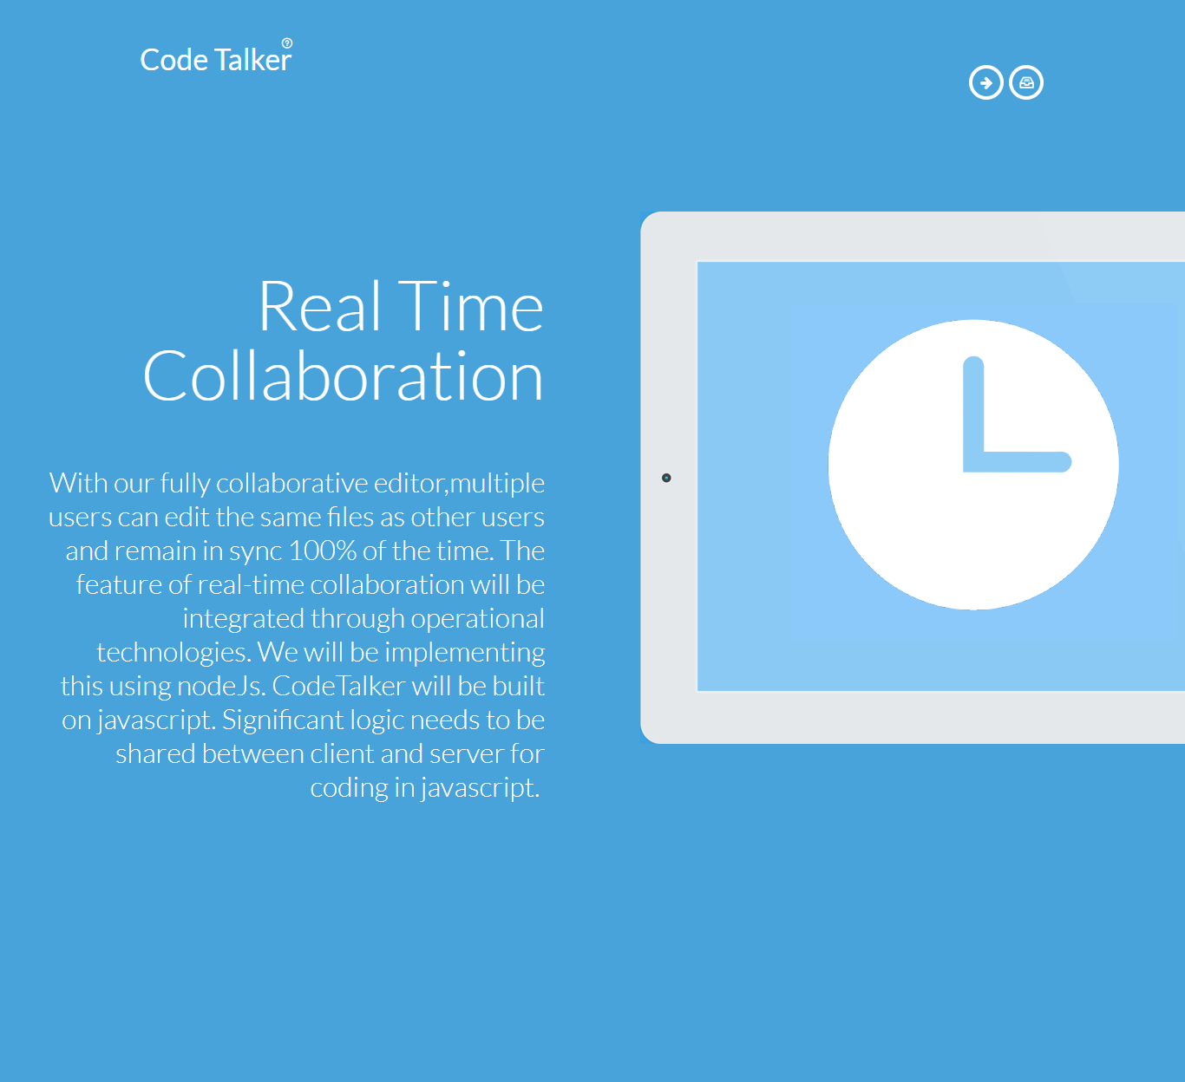
Home Page
Login and
Register
button

Slide 3
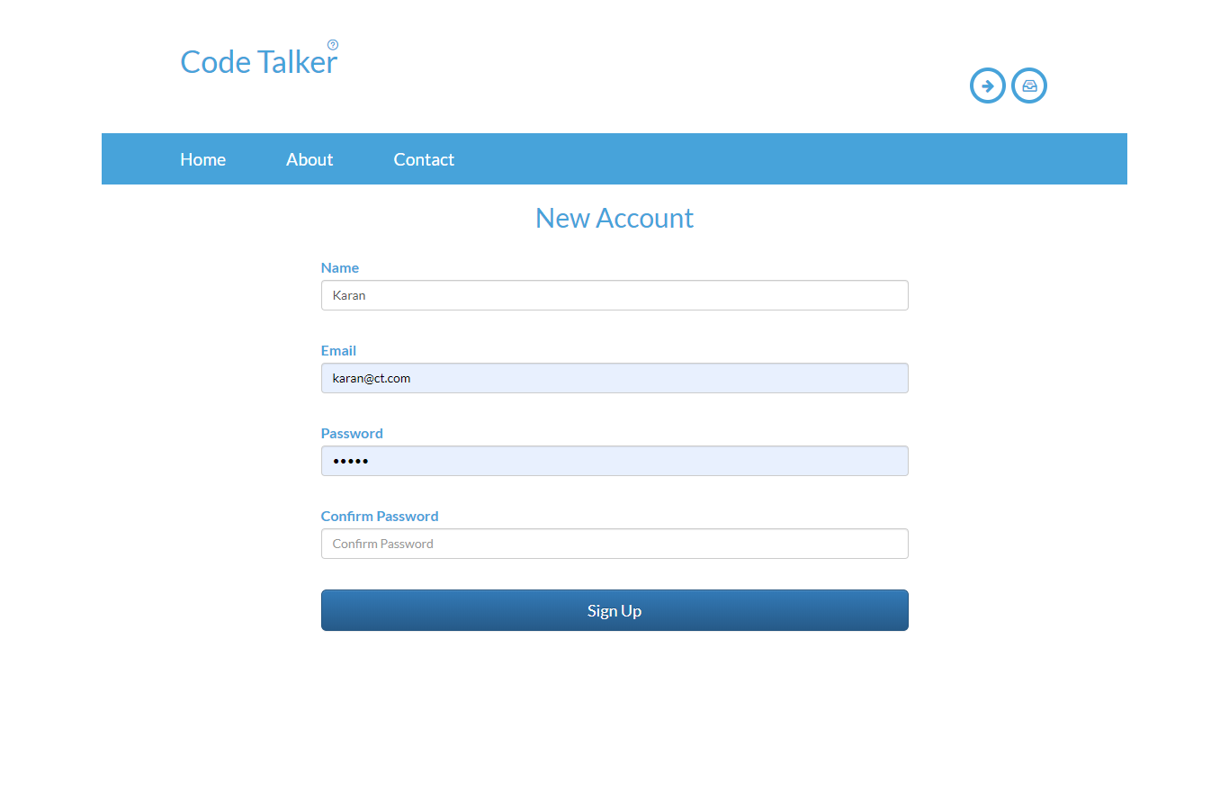
Register Page
Navigation bar
Register form
With required
Inputs

Slide 4
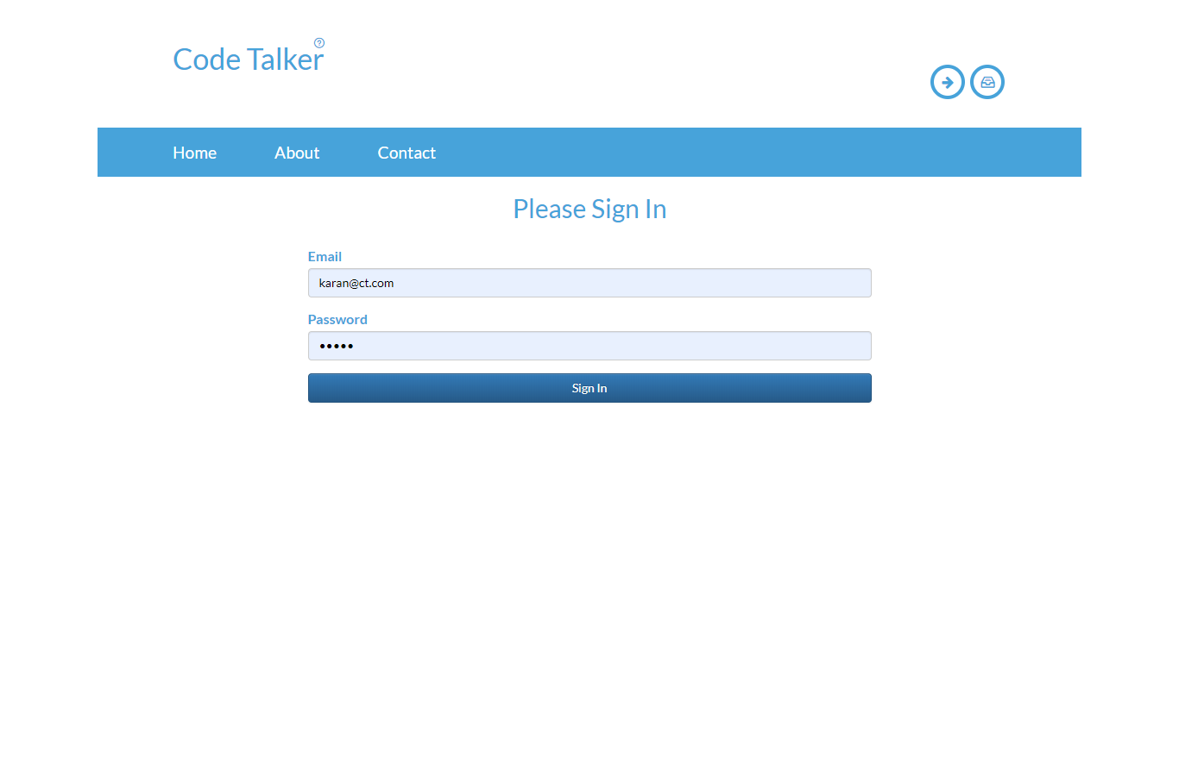
Login Page
Switch to
Register page
Authenticate with registered
username and password

Slide 5
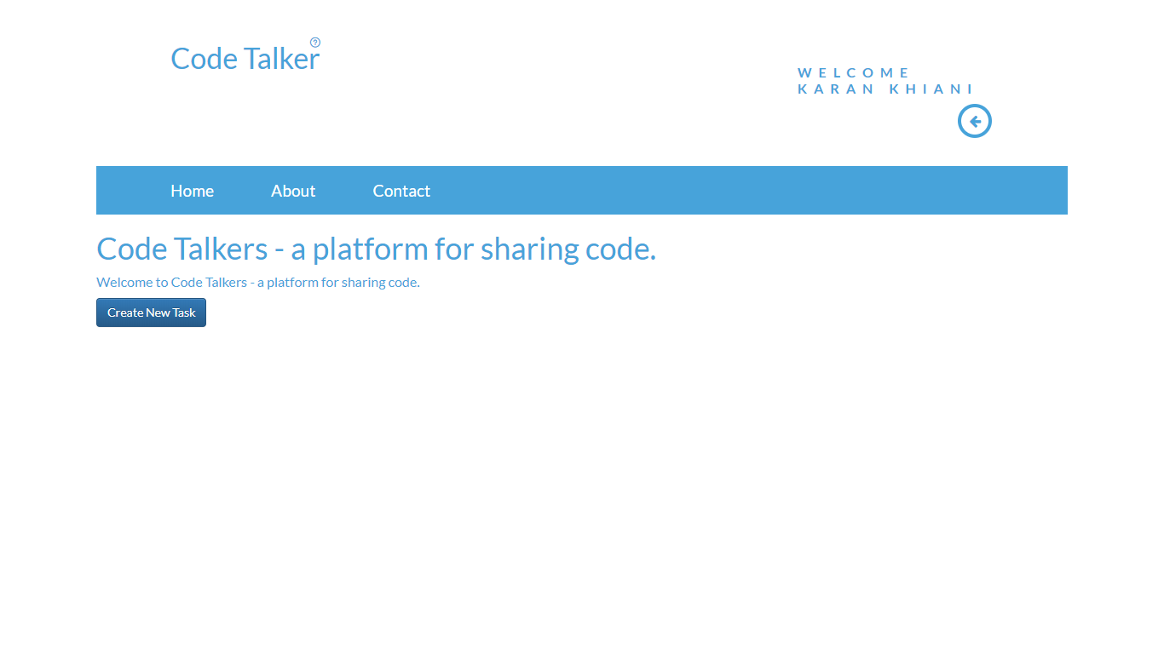
Create Task Page
Welcome message
With name
Create new task
With unique task id
Logout button

Slide 6
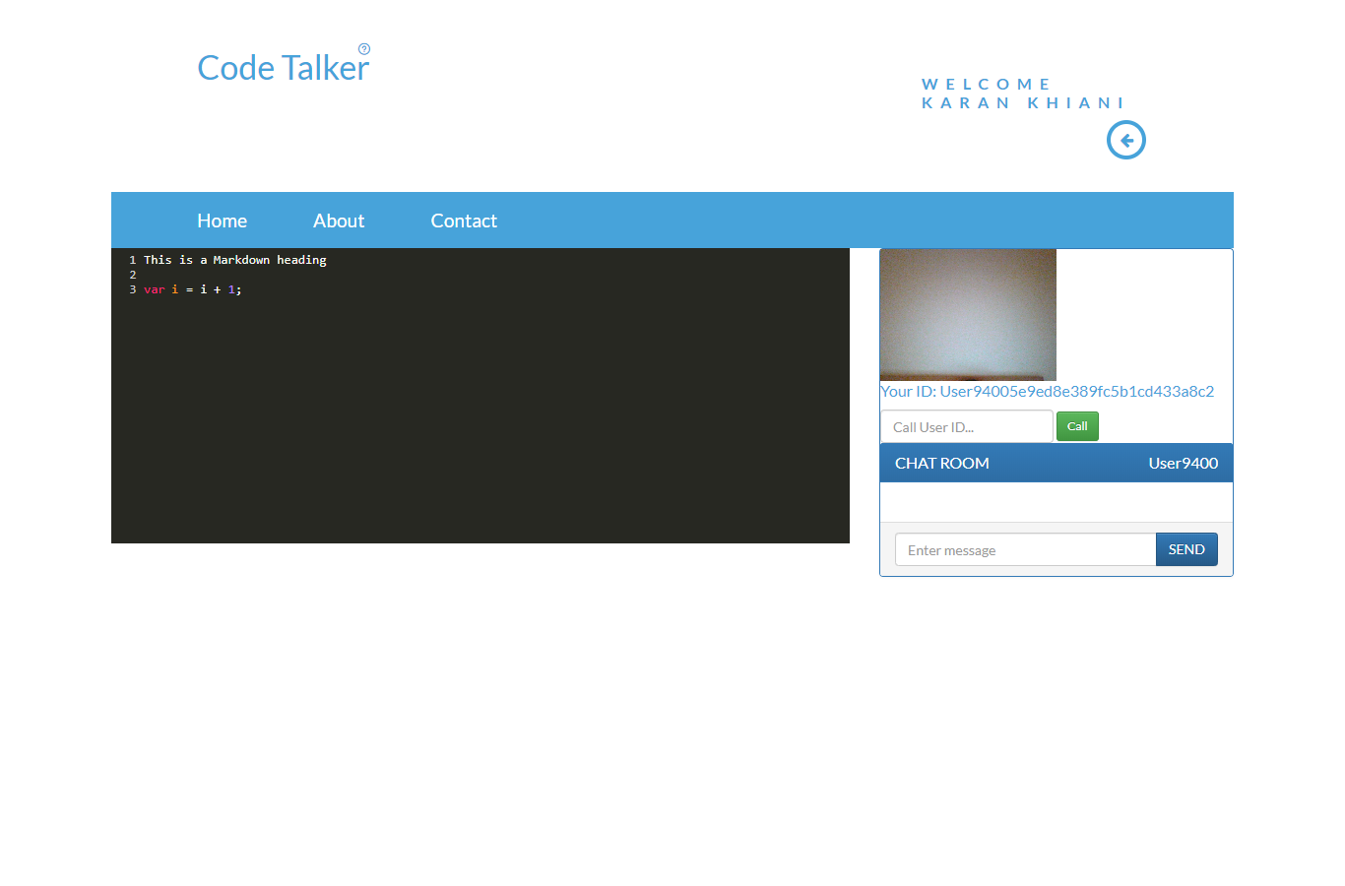
Code editor Page
Video call
display
Real time editor
Chat app feature
Unique user id

Slide 7
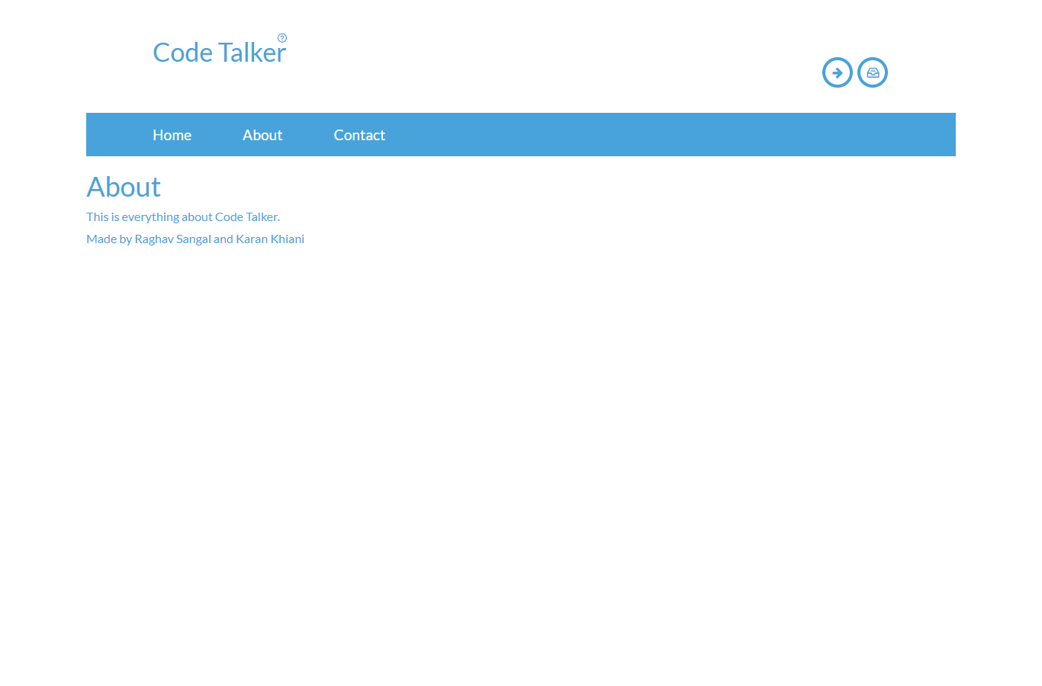
About Page

Slide 8
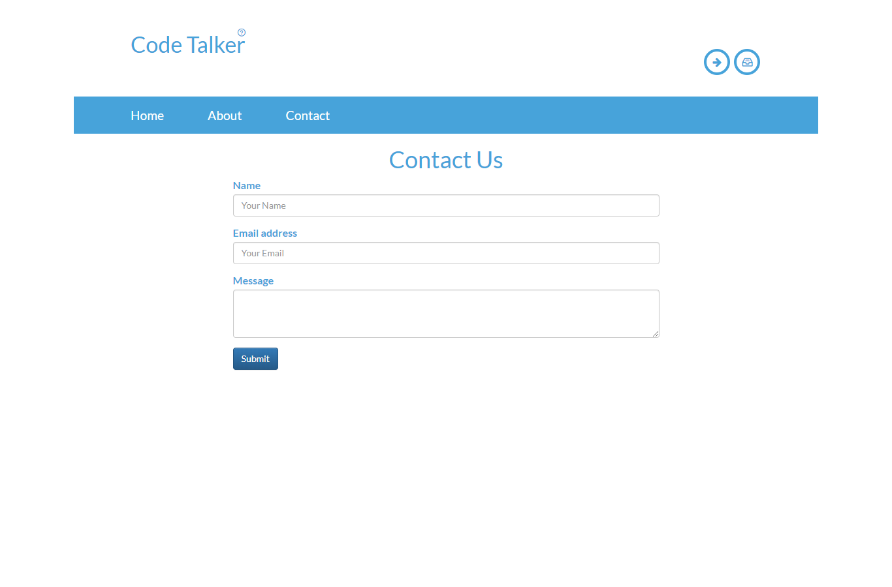
Contact Us Page

Slide 9
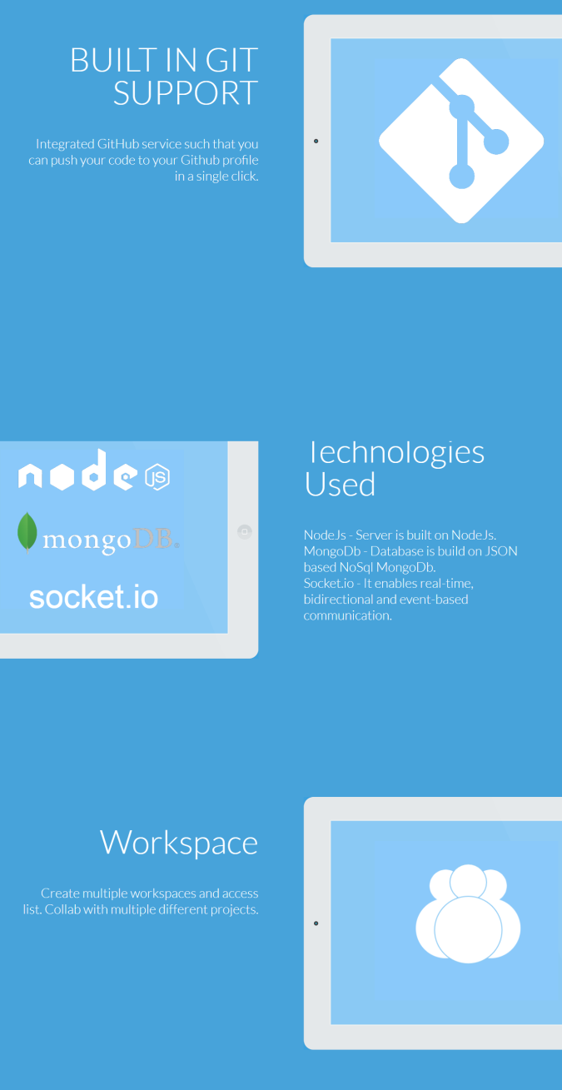

UI Design of Home Page

